Slide 1
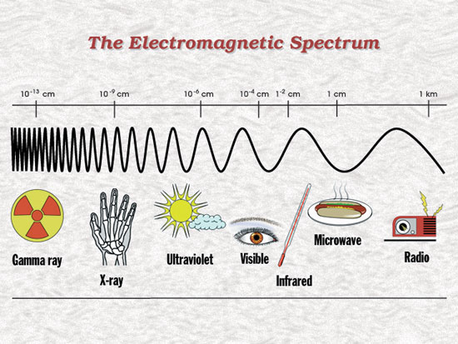
All EM waves share the following properties:
They transfer energy from one place to another.
They are all transverse waves.
They can all travel in a straight line and can be reflected.
They can all travel through a vacuum.
They all travel at the speed of light in vacuum. (300 000 000 ms⁻¹ ) (NOTE Speed of sound = 340m/s.
They all obey the wave equation (v = f × λ).
The shorter the wavelength, the more dangerous they are.

Slide 2
VISIBLE LIGHT
Year 9

Slide 3
What do you already know?
Decide whether the following statements are true (stand up) or false (sit down).

Slide 4
True or False
(stand up for ‘True’ and sit down for ‘False’)
Light from the Sun can travel further than light from a candle
False
Light always keeps travelling until it hits something else. Light from a candle can travel just as far as light from the Sun.

Slide 5
Cats can’t see anything at all in a totally darkened room
True
People, cats and most other animals can only see things that are producing light or that have light reflecting off them.

Slide 6
We see things because light travels from our eyes to the object we are looking at
False
We see objects because light travels from the object towards our eyes. It enters our eyes and forms an image on the retina at the back of our eyes.

Slide 7
A lens helps to form images because it bends light
True
As light passes through a lens, it changes direction. This is called refraction and is the reason that lenses help to form images.

Slide 8
Light from a candle does not travel as far during the daytime
False
Light travels the same distance whether it is daytime or night-time. It is just that we cannot see the effects of this light as clearly during the daytime because there is so much other light around.

Slide 9
A red object looks red because it only reflects red light
True
Coloured objects appear to be a certain colour because they absorb all colours apart from the colour we see. White objects reflect all colours equally. Black objects absorb all colours of light so there is very little light reflected for us to see.

Slide 10
We can only see things that are making light
False
We can also see things that are light reflectors. Light from another source, such as the Sun, reflects off objects and travels to our eyes.

Slide 11
Light keeps travelling until it hits something
True
Light always keeps travelling until it hits something else. It can then be absorbed, reflected or change direction as it passes through that object.

Slide 12
Today’s Learning Objective:
Learn and use scientific vocabulary relating to light.
To be able to use a light box.
Understand the Law of Reflection
Understand bending light = refraction

Slide 13
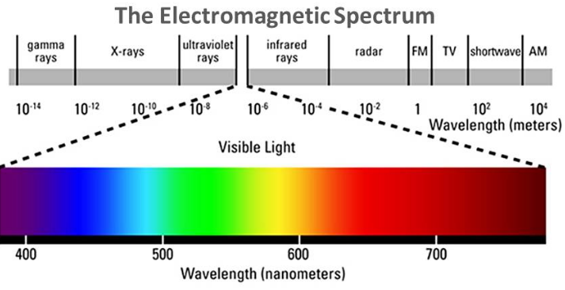
What is Visible Light?
* Light is the only type of electromagnetic radiation that is visible to the human eye.
* Light waves have wavelengths between 390 - 780 nm.
* The different wavelengths of light are seen as the different colours of the spectrum.

Slide 14
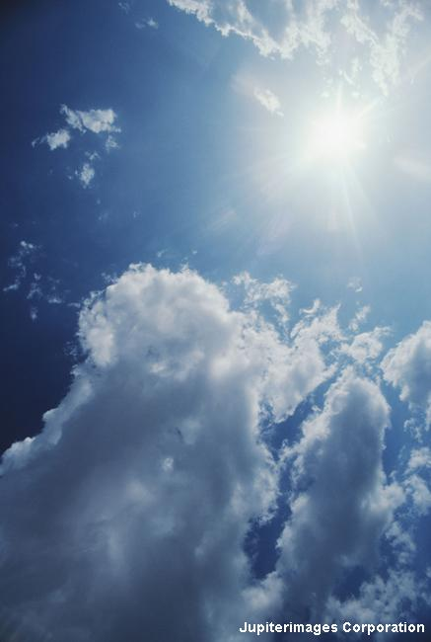
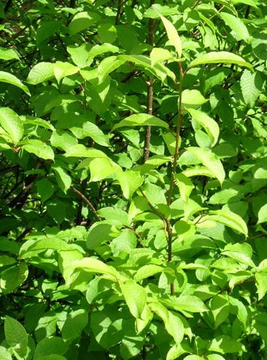
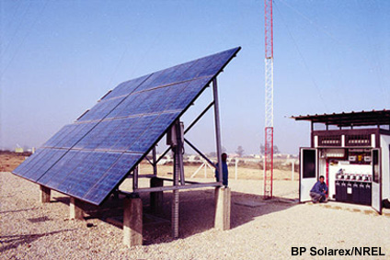
What is Visible Light?
* Light carries energy and travels as a wave.
* Light is a form of energy and can be changed from one form into another.
* Objects that give out light are called luminous.
Eg: the sun and light globes
* All other objects are non-luminous. Eg: the moon
Light -> electrical energy
Light -> chemical energy
Notes:
Photo credit: © 2008 Jupiterimages Corporation

Slide 15
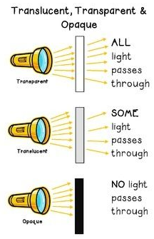
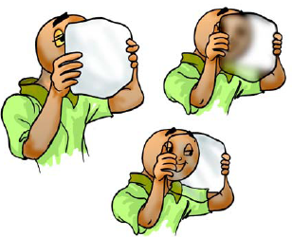
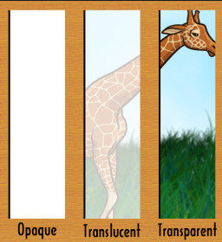
Vocabulary
Transparent
Transmits light so that details behind the object can be clearly seen. E.g. glass windows.
Translucent
Transmits some light so that details cannot be seen clearly. E.g. tracing paper/frosted glass
Opaque
Does not let light transmit. All light is absorbed or reflected. E.g. wood
Notes:
Photo credit (top right): Tom Denham
A digital SLR camera.
Photo credit (bottom left): © 2006 Jupiterimages corporation
Evening view of Coast Guard Nobska Lighthouse at Cape Cod, Massachusetts, USA.

Slide 16
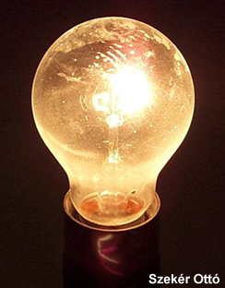
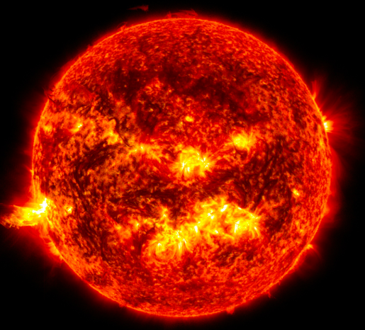
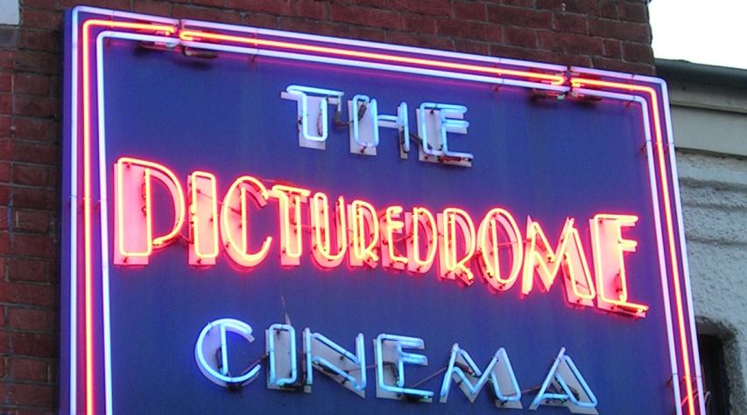
How is light produced?
Visible light is emitted by very hot objects.
The filament of this light bulb reaches a temperature of 2500°C and glows ‘white hot’.
The Sun, produces light energy by the nuclear fusion reactions that take place in the Sun.
Neon lights contain gases that emit visible light when an electrical current is passed through them.
Notes:
Photo credit (top right): Szekér Ottó
Filament light bulb.

Slide 17
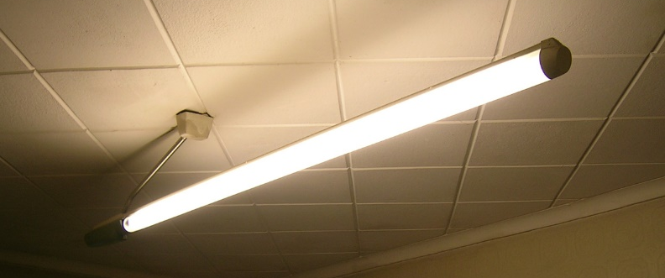
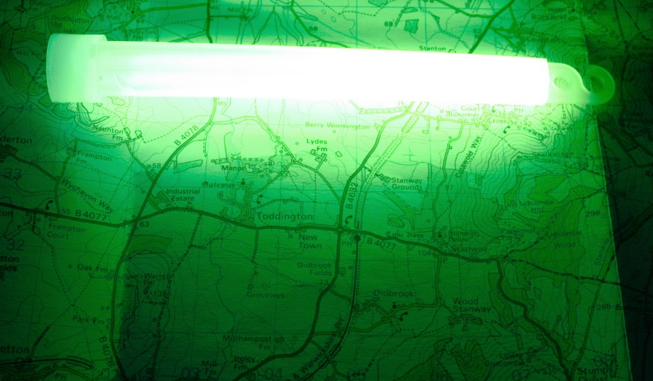
How else can light be produced?
Certain chemicals can emit visible light when struck by ultraviolet radiation. This process is called fluorescence.
Chemical reactions can also emit energy as visible light. This is called chemiluminescence.
Some biological organisms have the ability to produce light. This is bioluminescence.
Notes:
Fluorescent tubes contains mercury vapour, which generates ultraviolet radiation an electrical current is passed through it.
This UV radiation hits the fluorescent coating on the inside of the tube and creates visible light .

Slide 18
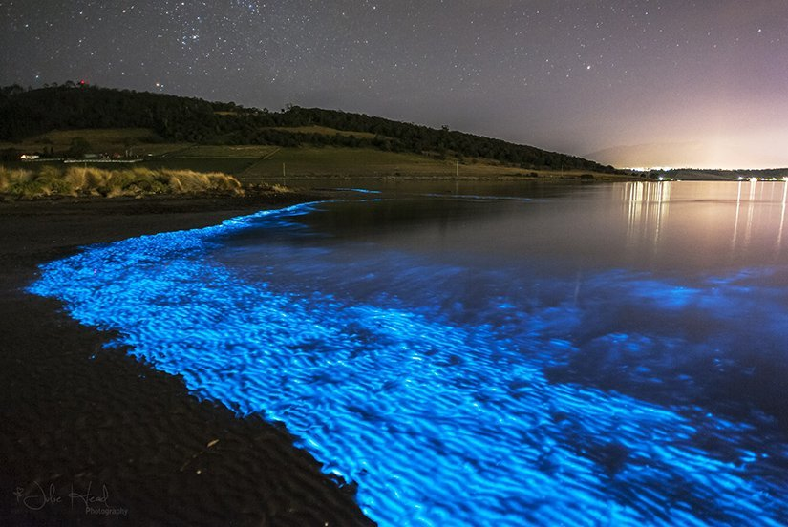
Bioluminescence (Hobart)

Slide 19
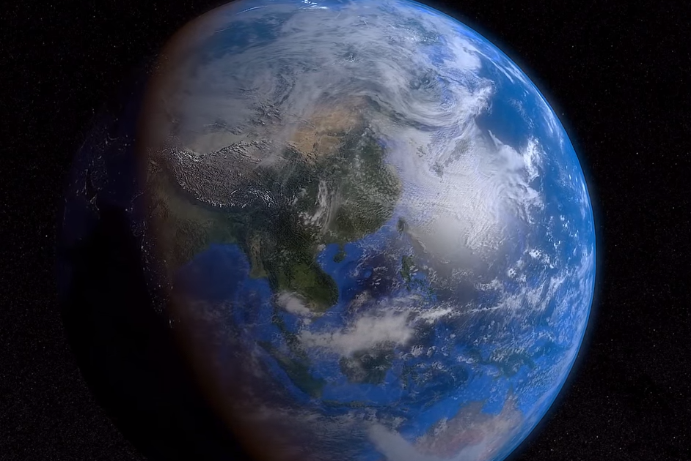
The Earth’s Rotation: Watch a few rotations

Slide 20
Summary Sentence
(3 minutes)
Write a summary sentence to explain why we experience day and night.
You must use the following words:
LIGHT EARTH ROTATE OPAQUE SHADOW
STRAIGHT LINE

Slide 21
Day and Night
As the Earth rotates, light falls on the area facing the
sun causing daytime; because light travels in a straight
line and Earth is opaque, the other side is in shadow,
causing night time.

Slide 22
Practical
Light Box and Refraction

